Slide 1



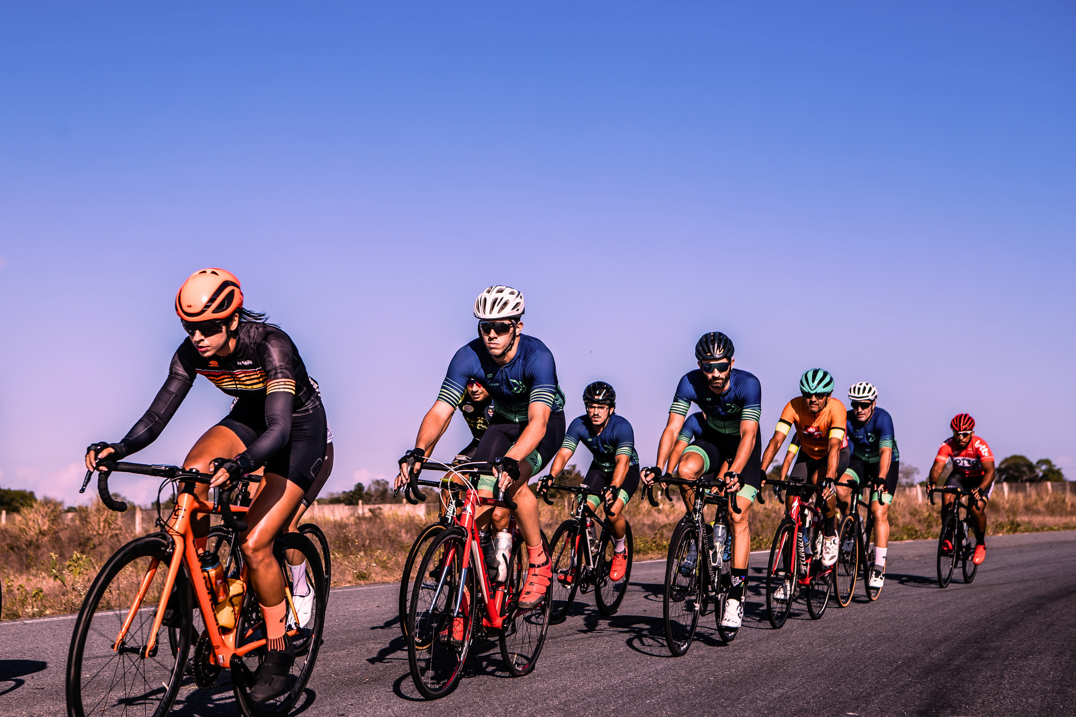


CONVERTING CASUAL RIDERS TO MEMBERS: A STRATEGY FOR GROWTH & PROFIT
Insights from First 6 months of 2024 Cyclist Trip Data
Name: Meera Bhardwaj
Date: 27th June,2025

Slide 2


Executive Summary
How to convert casual riders into committed members, aiming to boost recurring revenue and overall profitability.?
Business Problem
Core Insights
Casual riders, while a significant segment, have distinct usage patterns (longer, leisure-focused, weekend-heavy, and attraction-based rides).
By understanding and specifically tailoring membership value propositions to these casual usage patterns, we can effectively convert them into members
Recommendation

Slide 3



Business Task
Challenge:
How to convert casual riders to annual members to increase our profitability?
Effectively analyse trends and patterns in the usage of bikes by casual riders and member riders.
Task:
Target:
Our aim l is to leverage these insights to inform a data-driven marketing strategy.

Slide 4

Our Approach
DATA-DRIVEN INSIGHTS
DATA TOOLS
Processed and analyzed data using SQL (BigQuery) and visualisation through Google Sheets
DATA SOURCE
AIM
Utilized Cyclistic's publicly available trip data from
[Jan-Jun 2024]
Identified key behavioral patterns to distinguish casual from annual usage.

Slide 5

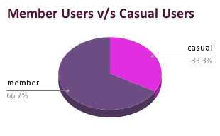
Current User Landscape
Members:
Members v/s Casuals
Represent the majority at 66.7% of the user base. These are our committed, recurring revenue customers.
Casuals:
Account for a significant 33.3% of the user base. This segment represents a substantial untapped potential for conversion and increased revenue.

Slide 6

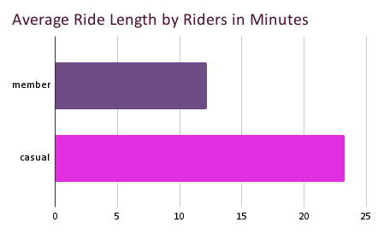
Rider Behavior:
Key Insights
Casuals are taking much longer, potentially recreational or sightseeing rides. This implies they are incurring higher per-minute costs.
MEMBERS:
Average ride length is significantly shorter, around 12 minutes., suggesting more purposeful trips.
CASUALS:
Average ride length is approximately 23-24 minutes.

Slide 7
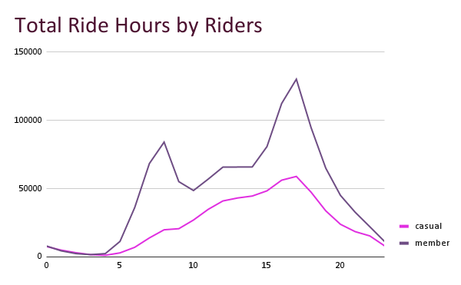

Total Ride Hours:
Hourly Peaks
CASUALS: Usage is consistently lower than members throughout the day. Their peak usage is broader and flatter, primarily in the afternoon (2 PM - 6 PM).
INSIGHT
Members: Exhibit clear commuter peaks in the morning (around 8-9 AM) and a larger peak in the late afternoon/early evening (5-7 PM).
Casuals are less likely to be commuters, instead using bikes for midday activities or leisure.
Members primarily use the service for daily commutes and errands.

Slide 8

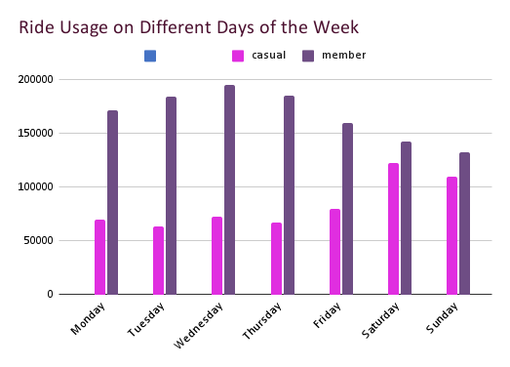
Ride Usage on Different
CASUAL INSIGHT
Days of the Week
Weekends are prime conversion opportunities for casuals, indicating a leisure-focused usage pattern.
Casuals: Show a distinct preference for weekend usage (Saturday & Sunday).
Members: Show significantly higher usage on weekdays (Monday-Friday).
MEMBER INSIGHT
This reinforces the daily utility and commuter aspect of member usage.

Slide 9
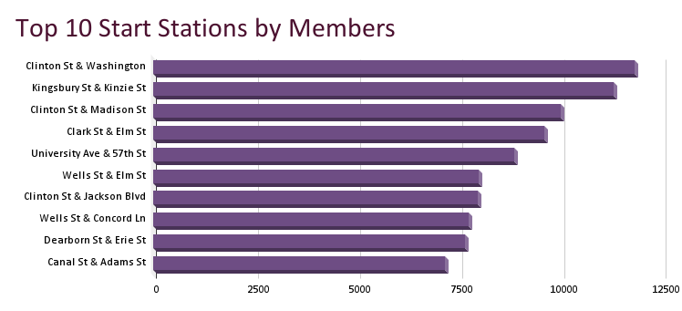
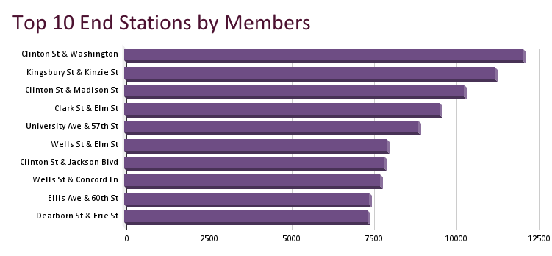
Top 10
Hot Stations by Members
Top stations (e.g., Clinton St & Washington, Kingsbury St & Kinzie St) appear to be concentrated in central business districts, residential areas, and transport hubs.
Confirms the utility-driven, point-to-point travel for members.

Slide 10
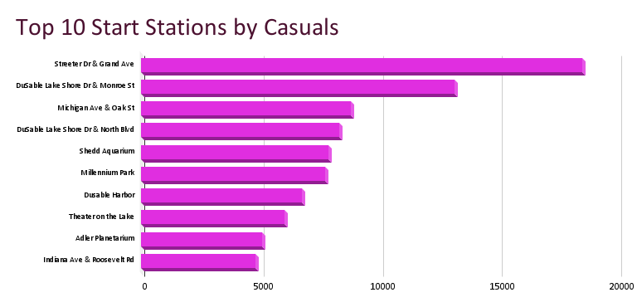
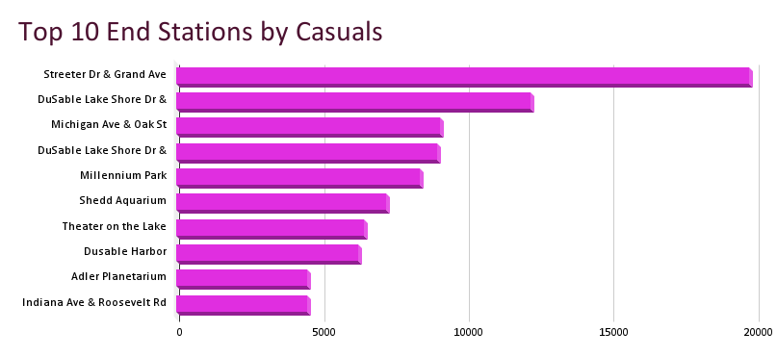
Top 10
Hot Stations by Casuals
Top stations (e.g., Streeter Dr & Grand Ave, DuSable Lake Shore Dr, Millennium Park, Shedd Aquarium, Theater on the Lake, Adler Planetarium) are predominantly located near tourist attractions, parks, and recreational areas.
Casuals are using the service to explore and enjoy leisure activities, often making round trips to popular destinations.

Slide 11
The Opportunity: Converting Casuals to Members
Targeted Strategies
Increased Recurring Revenue
Higher Customer Lifetime Value (CLTV)
Enhanced Customer Loyalty
Reduced Transaction Costs

Slide 12
Top 3 Conversion & Profit Strategies
Implement a "Weekend Explorer" Membership Tier or Targeted Promotion
Strategic On-Site & Digital Campaigns at Casual Hotspot Stations
Personalized Cost-Savings & Usage-Based Conversion Prompts

Slide 13
Conclusion
By leveraging insights into casual rider behavior and strategically highlighting the value of membership where it aligns with their needs.
The focus on weekend users, hotspot locations, and personalized financial incentives provides a clear path to converting casual riders into a valuable, loyal member base

Slide 14


THANK YOU!

